Slide 1
Multi-generational Marketing and Social Media Planning
Miguel Jackson • December 7, 2022
2022 NC AHEC Statewide Meeting: Celebrating 50 Years
Notes:
Multi-generational Marketing and Social Media Planning

Slide 2
Context
NC AHEC is currently using Campaigner to market Professional, Continuing, and Online Education (PCO) via email. Over the past four years, NC AHEC, like many others, has seen an influx of learners from many different generations (in large part due to COVID-19).
However, NC AHEC wants to tap into a younger client base without neglecting its mid-career audience.
How can NC AHEC effectively tap into a multi-generational audience using social media and how do they design and maintain strategic planning for major social channels?
Notes:
NC AHEC is currently using Campaigner to market Professional, Continuing, and Online Education (PCO) via email: the past four years, NC AHEC, like many others, has seen an influx of learners from many different generations. (In large part due to COVID-19)
However, NC AHEC wants to tap into a younger client base without neglecting neglecting the mid-career audience.
The question that arises is: How can NC AHEC effectively tap into a multi-generational audience using social media and how do you design and maintain strategic planning for major social channels?

Slide 3
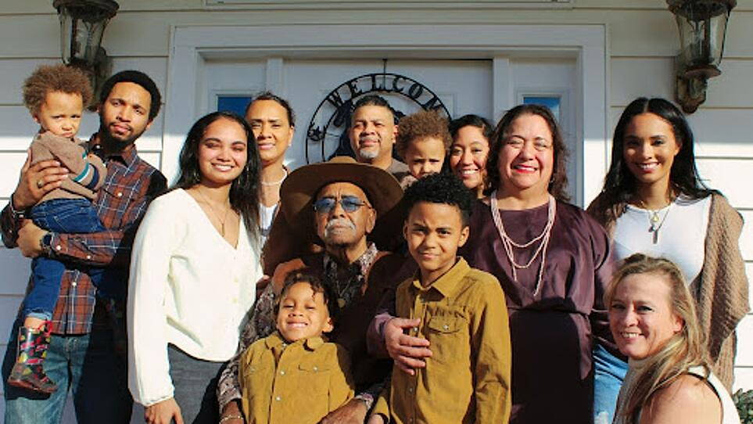
Six Living Generations
in America
Notes:
Six Living Generations in America

Slide 4
GI Generation
Born 1901-1926 (121 to 96)
Children of the WWI generation & fighters in WWII & young in the Great Depression.
Community-minded.
Strong loyalty to jobs, groups, schools, etc.
There was no “retirement.” You worked until your died or couldn’t work anymore.
Avoid debt…save and buy with cash.
Age of radio and air flight; they were the generation that remembers life without airplanes, radio, and TV.
Notes:
GI Generation

Slide 5
Mature/Silents
Born 1927-1945 (95 to 77)
Went through their formative years during an era of suffocating conformity, but also during the postwar happiness: Peace! Jobs! Suburbs! Television! Rock ‘n’ Roll! Cars!
The First Hopeful Drumbeats of Civil Rights.
They are avid readers, especially newspapers.
The Big-Band/Swing music generation.
Strong sense of trans-generational common values and near-absolute truths.
Notes:
Mature/Silents

Slide 6
Baby Boomers
Born 1946-1964 (76 to 58).
Ushered in free love and societal “non-violent” protests that triggered violence. Optimistic, driven, and team-oriented.
Too busy for much neighborly involvement yet strong desires to reset or change common values for the good of all.
The first TV generation.
Envision technology and innovation as requiring a learning process.
Notes:
Baby Boomers

Slide 7
Generation X
Born 1965-1980 (57 to 42).
The “latch-key kids.”
Very individualistic.
This generation averages seven career changes in their lifetime. It was not the norm to work for a company for life, unlike previous generations.
Raised in the transition phase of written-based knowledge to digital knowledge archives. Most remember being in school without computers and the introduction of computers in middle school or high school.
Into labels and brand names.
Notes:
Generation X

Slide 8
Millennials (Gen Y)
Born 1981-2000 (41 to 22).
They schedule everything.
They feel enormous academic pressure.
Prefer digital literacy as they grew up in a digital environment. Have never known a world without computers! They get all their information and most of their socialization from the Internet.
Prefer to work in teams.
Unlimited access to information, they tend to be assertive with strong views.
Envision the world as a 24/7 place; want fast and immediate processing.
Notes:
Generation Y

Slide 9
Generation Z
Born after 2001 (21 and younger).
In 2006 there were a record number of births in the US. A total of 4,265,555 births were registered in the United States in 2006, 3 percent more than in 2005, and the largest number of births in more than four decades.
With the advent of computers and web-based learning, children leave behind toys at younger and younger ages. It’s called KGOY… kids growing older, younger
Less interested in toys and begin to desire electronics such as cell phones and video games.
They have never known a world without computers and cell phones.
Notes:
Generation Z

Slide 10
Baby Boomers, Gen Xers, Millennials, and Gen Zers make up the majority of adults in the United States.
Notes:
Baby Boomers, Gen Xers, Millennials, and Gen Zers make up the majority of adults in the United States.
293 million adults in total.

Slide 11
Each of the six living generational groups connects with organizations differently online. This generational difference might pose a few issues for companies with limited resources that must be all things to all people.
Understanding the multiple generational disparities can assist mission-driven organizations in cultivating community partnerships and achieving organizational goals.
Notes:
Each of the six living generational group connects with organizations differently online. This generational difference might pose a few issues for companies with limited resources that must be all things to all people.
Understanding the multiple generational disparities can assist mission-driven organizations in cultivating community partnerships and achieving organizational goals.

Slide 12
What is Multi-generational Marketing?
Notes:
Multi-generational marketing is the practice of appealing to the unique needs of individuals within more than one specific generational group. For the purposes of this discussion, a generation is defined as a group of individuals born and living about the same time. These group members often encounter similar economic, sociologic, and political experiences, and these experiences play a role in shaping generational values, needs, and interests.

Slide 13
Multigenerational marketing theory is based on two founding principles:
consumer needs change with life stages, and
(2) advertising campaigns targeting generational groups that reflect generational values may influence consumer behavior.
Notes:
Multigenerational marketing theory is based on two founding principles: (1) consumer needs change with life stages, and (2) advertising campaigns targeting generational groups that reflect generational values may influence consumer behavior.

Slide 14
How to Develop a Successful Multi-generational Marketing Strategy
Notes:
How to Develop a Successful Multigenerational Marketing Strategy

Slide 15
Identify each generational cohort represented in your organization’s target audience.
Segment
Conduct Market Research
Notes:
Multigenerational marketing theory is based on two founding principles: (1) consumer needs change with life stages, and (2) advertising campaigns targeting generational groups that reflect generational values may influence consumer behavior.

Slide 16
Incorporate generation-specific marketing strategies into your overall marketing strategy.
Notes:
Incorporate generation-specific marketing strategies into your overall marketing strategy.

Slide 17
Understand the backgrounds, characteristics, lifestyle preferences, priorities, and values of each generation identified within the target audience.
Recognize the different behavior of generations and use unique and targeted marketing approaches based on this uniqueness. Influencers…
Additionally, organizations should pay attention to generational lifecycles
Notes:
Understand the backgrounds, characteristics, lifestyle preferences, priorities, and values of each generation identified within the target audience.
As appropriate, adjust marketing strategies accordingly. Recognize the different behavior of generations and use unique and targeted marketing approaches based on this uniqueness.
An example of this would be developing an influencer campaign to capture Gen Z and Millennial audiences, and a nostalgia-based campaign for Baby Boomers and Gen Xers. Additionally, organizations should pay attention to generational lifecycles.
The brands and purchases that Millennials prioritized ten years ago may not be what they prioritize right now - priorities change in response to life events.

Slide 18
Prioritize the development of brand-market relationships.
Notes:
Prioritize the development of brand-market relationships.

Slide 19
Marketers should build relationships with each specific generation represented in their targeted audience or community.
Each generation has preferred methods of communication and trusted sources of information that the marketer should understand and use.
Notes:
Marketers also need to build relationships with each specific generation represented in their targeted audience or community. For example, each generation has preferred methods of communication and trusted sources of information that the marketer should understand and be using. It is the marketers’ (OUR) responsibility to know and understand their specific markets.

Slide 20
Authentic marketing is effective for all generations.
Notes:
Authentic marketing is effective for all generations.

Slide 21
All generations are increasingly skeptical of marketing techniques that feel intrusive and spammy.
Successful marketing campaigns invite the target audience to engage with the brand - they do not intrude on the target audience’s lives, inboxes, or social media feeds.
Notes:
Marketing strategies that feel obtrusive and spammy are increasingly unpopular among all generations. Because of the internet, unethical firms can easily exploit target populations through deceptive digital marketing strategies. When designing a multigenerational marketing strategy, the firm should assess the authenticity of each part of the campaign. Successful marketing efforts invite the target audience to interact with the brand rather than intruding on their lives, inboxes, or social media feeds.
”Creepy Factor”

Slide 22
Social media should be a priority for all modern marketing strategies.
Notes:
Social media should be a priority for all modern marketing strategies.

Slide 23
Social media is utilized by Baby Boomers, Generation X, Millennials, and Generation Y.
While generations are active on social media, each generational cohort uses social media platforms differently.
Consider gearing your brand’s social media presence on each channel to one or two generational audiences when appropriate.
Notes:
Social media is utilized by Baby Boomers, Generation X, Millennials, and Generation Y; thus, social media will be included in any effective multigenerational marketing strategy. While generations are active on social media, each generational cohort uses social media platforms differently. Consider gearing your brand’s social media presence on each channel to one or two generational audiences, when appropriate. For example, Snapchat and Instagram may be best suited for Millennials and Gen Zers, while Facebook and LinkedIn may be better suited for Gen Xers and Baby Boomers due to usage patterns. Recognize that not only are the generations on different platforms, but also, they use social media in different ways - for different purposes.

Slide 24
New Social Media Trends
Notes:
New Social Media Trends

Slide 25
Video is key to marketing success.
Invest in Long-Form content.
Create social media platform-specific content.
Notes:
While creative copy and beautiful images have their place, video content is becoming increasingly popular among social media users. One of the keys to marketing success in 2022 will be short movies that rapidly capture attention, offer a well-crafted message, and urge user action. Videos are no longer limited to YouTube. Skilled communications and marketing specialists will incorporate video material, as well as online, e-newsletter, and social media ad content, into a multi-channel social media strategy. Video facilitates audience engagement by engaging many senses and offering both spoken and nonverbal communication. Remember to analyze content accessibility and take efforts to improve 508 compliance by using closed captioning and transcript options when using video content.
For years, the trend in marketing has been to shorten the duration of advertising content. We moved from 15-minute TED Talks to TikToks in 15 seconds. While average attention spans have been claimed to have decreased in recent years, long-form material, such as mini-documentaries and instructive blogs, continues to be popular (and valuable!) in terms of successful marketing content. When consumers come upon a fascinating post about a brand or organization they are unfamiliar with, they look for additional information. Short-form, attention-grabbing marketing content can be supplemented by longer-form, instructive content made available to interested parties. As visitors proceed from the window display (short-form content) to examining the wares inside the figurative store, such synergy between short-form and long-form content might assist a sort of sales funnel (long-form content). Organizations that only create short-form content miss out on great possibilities to establish relationships and attract brand ambassadors. Organizational leaders should prioritize the creation of high-quality long-form content in 2022.
Too often, busy marketers will share the same information across various social media sites. When various platforms have diverse audiences and features, cross-posting might reduce content returns while also harming perceptions of the organization's capabilities and value. Cross-posting the same material across various social media platforms saves time; but, smart marketers will set aside enough time and resources to generate platform-specific social media content. What works well on one platform may not work well on another.

Slide 26
What Not To Do When Marketing to Multigenerational Audiences.
Notes:
What Not To Do When Marketing to Multigenerational Audiences

Slide 27
Don’t assume that everyone in the same age bracket will behave the same.
Segments exist within generational cohorts, such as “yuppies” and “hipsters.”
Customize all marketing strategies to your target audiences and their demonstrated consumer behavior.
Notes:
Segments exist within generational cohorts, suck as “yuppies” and “hipsters.”
Customized all marketing strategies to your specific target audience and their demonstrated consumer behavior.

Slide 28
Don’t assume younger generations are the most price-conscious due to their lower income and net worth status.
Baby Boomers are observed as being more price-conscious than Millennials, who earn, on average, less than Baby Boomers.
Notes:
Baby Boomers are actually observed as being more price-conscious than Millennials, who earn, on average, less than Baby Boomers.

Slide 29
Don’t assume all young demographics are active on social media and that all older demographics consume traditional media.
Baby Boomers are currently the fastest-growing segment of Facebook users.
Traditional marketing tactics, such as direct mail and radio, are increasingly successful with Gen Xers.
Notes:
Baby Boomers are currently the fastest-growing segment of Facebook users.
Traditional marketing tactics, such as direct mail and radio, are increasingly successful with Gen Xers.

Slide 30
What now?
Notes:
What Now?

Slide 31
Social Media Strategic Planning
Notes:
Strategic Planning in four stages (Strategic Development, Develop Capabilities, Engagement, Learning).

Slide 32
Prioritize Objectives
Improve customer engagement
Enhance brand and reputation management
Accelerate customer-driven innovation
Attract talented employees
Increase sales
Strategic Development
Notes:
Improve customer engagement
Enhance brand and reputation management
Accelerate customer driven innovation
Attract talented employees
Increase sales

Slide 33
Establish Governance
Identify opportunities
Understand risks
Clarify the risks of not engaging
Set clear social media practices
Communicate policies internally
Strategic Development
Notes:
Identify opportunities
Understand risks
Clarify risks of not engaging
Set clear social media practices
Communicate policies internally

Slide 34
Define Activities
Define the first and subsequent phases
Target initial platforms
Identify resources required
Establish responsibilities and time commitments
Link to marketing activities
Strategic Development
Notes:
Define first and subsequent phases
Target initial platforms
Identify resources required
Establish responsibilities and time commitments
Link to marketing activities

Slide 35
Develop Capabilities
Identify internal champions for social media
Train and support champions and staff
Keep abreast of developments
Establish pilot programs
Develop a culture of responsible transparency
Develop
Capabilities
Notes:
Identify internal champions for social media
Train and support champions and staff
Keep abreast of developments
Establish pilot programs
Develop a culture of responsible transparency

Slide 36
Measure and Refine
Set relevant measures for success
Monitor measurements
Capture and communicate success stories
Report to senior executives
Link to marketing activities
Engagement
Notes:
Set relevant measures for success
Monitor measurements
Capture and communicate success stories
Report to senior executives
Link to marketing activities

Slide 37
Engage in Conversation
Enter the conversation
Provide relevant content
Add value to communities
Engage with influencers
Respond positively
Engagement
Notes:
Enter the conversation
Provide relevant content
Add value to communities
Engage with influencers
Respond positively

Slide 38
Listen
Identify relevant social media monitoring tools
Learn how to best use the tools
Discover what’s said about you and your market
Find relevant communities and conversations
Uncover key influencers
Engagement
Notes:
Identify relevant social media monitoring tools
Learn how to best use the tools
Discover what’s said about you and your market
Find relevant communities and conversations
Uncover key influencers

Slide 39
Learning
Use social media yourself
Study relevant case studies
Educate senior executives
Hear from practitioners
Explore the latest trends
Learning
Notes:
Use social media yourself
Study relevant case studies
Educate senior executives
Hear from practitioners
Explore the latest trends

Slide 40
Questions?
Notes:
Questions?

